Slide 1


Leveraging Dataspaces for Coordinated Disaster Response
Konstantinos Tsampras
Supervisor: Spyros Denazis
Department of Electrical Engineering and Computer Science
University of Patras

Slide 2








The importance of Dataspaces
Literature
The problem
The solution: A Dataspace
People and businesses want access to data for cities
A digital ecosystem focused on providing access to pools of data and securing data exchanges for a transparent and safe environment
BUT each city has its own digital infrastructure
Data Sovereignty: The participants retain control of the data they contribute
Interoperability: Standards allow different systems to communicate effectively
They don’t know where and how to access it
They don’t know the reliability of datasets
Decentralization: The data comes from different participants across the network
Trust and Security: Certificate authorization ensures the safety inside the dataspace
People don’t want to just give up their data

Slide 3







Dataspace Projects
Literature
A Dutch Dataspace initiative that has spread across the manufacturing supply chains in Europe.
Standardizing and automating the interactions between over 400 participants in the network, it has redefined the standards for manufacturer-supplier communication.
A German initiative about mobility data sharing across Germany and the EU. Initiatives that build on this platform:
Esri: A digital twin project for smarter planning
PrioBike-HH: A project enhancing cyclists’ safety in Hamburg
Mobias: A project centered around predicting and preventing accidents using AI trained on the Dataspace’s data
A project focused on providing a secure platform to unify primary and secondary health records of patients.
Funded by the German Ministry of Economic Affairs and Energy.
https://mobility-dataspace.eu/
https://www.health-x.org/en/home
https://smart-connected.nl/en

Slide 4

International Data Spaces Association (IDSA)
Literature
The development of Data Space platforms like the ones previously mentioned would not be possible without a standard-defining body.
This need created the IDSA: funded by the European Union, it is tasked with providing standards and support for Data Space platforms.
Most notably, it has created the IDSA Reference architecture model, defining the main participants in a Data Space, as well as the IDS Reference Testbed for Data Space deployments.

Slide 5
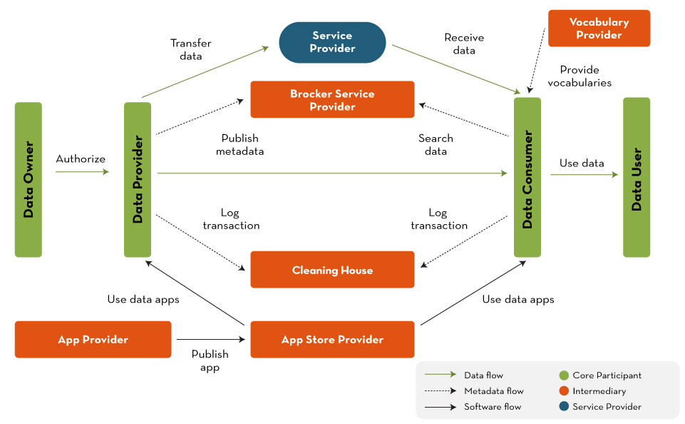
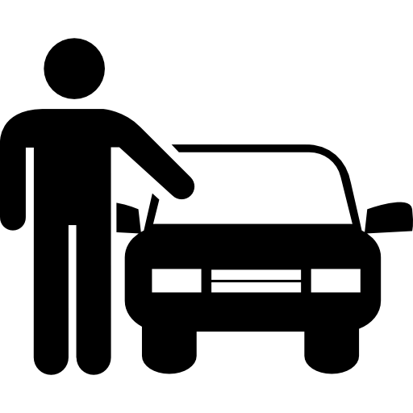



IDS Reference Architecture Model
Literature
https://datos.gob.es/en/blog/ids-ram-reference-architecture-model-and-its-role-data-spaces

Slide 6
Our mission: Evacuation planning
The Goal
Create a demo app for evacuating people with disabilities during natural disasters
Deploy a Dataspace providing relevant data
Several aspects of a dataspace are ideal for this scenario:
Trust and Security
Interoperability
Data Sovereignty
How?
Why a dataspace?
What kind of data will be shared?
Essential information about:
Vehicle fleet
People with disabilities
Natural disasters
Services and agencies such as:
Ministry of health
Clubs and individual People with disabilities
Civil protection (vehicles)
Agencies providing natural disaster info
Where will the data come from?

Slide 7











Copernicus effis API
Provider
MongoDB
SQL
Disasters API
Amea club API
Dataspace
Ecosystem
Get Unique URI
Provide self Description, title, maintainer, security profile
Get verified from DAPS
Connector
Amea Club
Create a connector
Fleet
Generator
Connector Natural Disasters
Create a Catalog
Catalog
Run the Connector software
Provide Certificates
Construct self Description
Create and link offer
Catalogs are collections of offers:
Name
Description
Publisher
Offer
Fiware Platform
Create rules, contract
and link
BROKER
Connector
Civil Service
Offers contain:
Metadata (title, keywords, data category)
Definition of the endpoint (e.g., API, data file)
Contract
register
A contract contains Rules. Rules are usage policies such as “data can only be used for research” in machine readable form.
Rules
Create Representation, Artifact and link
MongoDB
Repres.
DAPS
‘Mitroo’
API
Connector Mhtroo
Representation: Data format (Json, CSV)
Artifact: Data endpoint or file
Artifact

Slide 8
The Consumer decides which Connectors are relevant and proceeds to contact them via their access URLs.
Civil Protection Demo App
Consumer
Run the Connector software
Provide Certificates
Construct self Description
Create a Connector
Copernicus effis API
Connector Consumer
The Consumer queries for a list of all registered Connectors.
The Broker returns the list with access URLs and metadata.
MongoDB
Get Unique URI
Provide self Description, title, maintainer, security profile
Get verified from DAPS
Disasters API
Query for
Connectors
Register
SQL
Amea club API
Connector Natural Disasters
BROKER
Connector Amea Club
Connector
Civil Service
Fiware Platform
DAPS
MongoDB
‘Mitroo’
API
Connector Mhtroo
Fleet
Generator
Dataspace Ecosystem

Slide 9

The resource payload can either be a static resource or access to APIs that contains:
Access method
Acces URLs
Documentation
Credentials
SQL
Self-Descriptions provide:
Security profile, Maintainer, Version
Title, Description, Context
Catalogs list
Civil Protection Demo App
Contract
Representation
Keywords
Context
Negotiate
Return the formalized contract with:
Start and end dates
Agreement ID
Final usage policies
Amea club API
Copernicus effis API
Request self Description
Request resource payload
Propose contract (usage policies)
Query for offers in catalogs
Connector Amea Club
Connector Consumer
Provide resource payload
Provide offer related entities
Negotiate or accept
MongoDB
Provide self Description
Disasters API
Connector Natural Disasters
BROKER
Connector
Civil Service
Fiware Platform
DAPS
MongoDB
‘Mitroo’
API
Connector Mhtroo
Fleet
Generator
Dataspace Ecosystem

Slide 10


Data flow
Civil Protection Demo App
SQL
MongoDB
Amea club API
Disasters API
Connector Consumer
Connector Natural Disasters
Copernicus effis API
Connector Amea Club
Connector Mhtroo
BROKER
Connector
Civil Service
MongoDB
Fiware Platform
‘Mitroo’
API
DAPS
Fleet
Generator
Dataspace Ecosystem

Slide 11
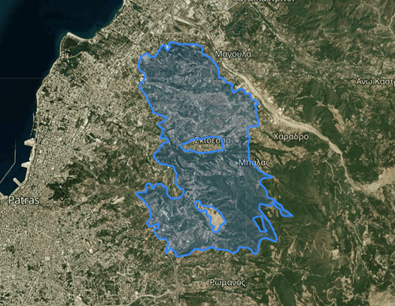
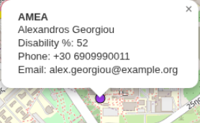


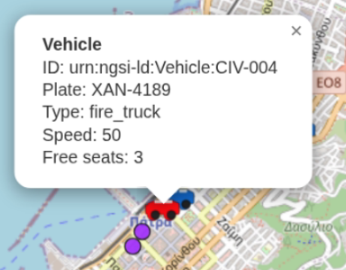

Data
Each vehicle has the following data attached to it:
License plate
Organization
Contact (email/sms)
Total seats
Available seats *
Location *
Speed *
* Is updated
Each person with disability record may come from the government or from a club they are registered to, with at least the following data:
Name
Contact
Location
Disability (and %)
Required medical assistance
Caretaker info
Personal Identification Number
Natural disasters need the following attributes when shared in the dataspace:
Affected area (polygon)
Type of disaster
Danger level
Start (and end) dates
Updated timestamps
Source of the disaster
Projected or historic affected areas (projected is used as evacuation zone)
Data sourced from the Copernicus API
https://forest-fire.emergency.copernicus.eu/apps/effis_current_situation/

Slide 12
Data flow
Civil Protection Demo App
SQL
MongoDB
Amea club API
Disasters API
Connector Consumer
Connector Natural Disasters
Copernicus effis API
Connector Amea Club
Connector Mhtroo
BROKER
Connector
Civil Service
MongoDB
Fiware Platform
‘Mitroo’
API
DAPS
Fleet
Generator
Dataspace Ecosystem

Slide 13




Application Design
Dataspace
Consumer Connector
Authentication
Dataspace interface controller
Front-end
Present entities
and info
Select vehicles & plan pickups
Amea club API
Fetch data loop
‘Mitroo’
API
Organize evacuation
/api/amea
/api/disasters
Assign targets (GCFR)
Disasters API
Create routes (ORS)
/api/fleet
Fiware Platform
Send emails (Nodemailer)
Driver notifications
https://github.com/ultrongr/IDS-Civil-Protection

Slide 14
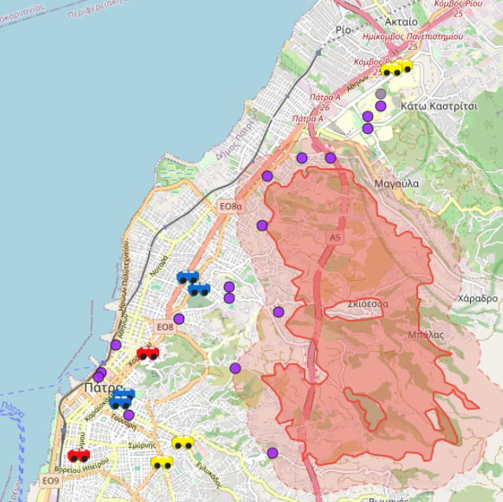
Demo app (overview)
The main page of the app offers an overview of the current situation:
The map of the relevant area (city of Patras).
The location of people with disabilities on the map.
The fleet and the type of vehicles available for assisting in evacuating
The area of natural disasters and the evacuation zone around them

Slide 15
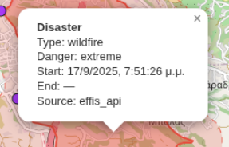

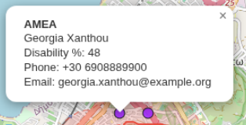
Demo app (information)
Relevant information about each entity can be revealed by clicking over it

Slide 16
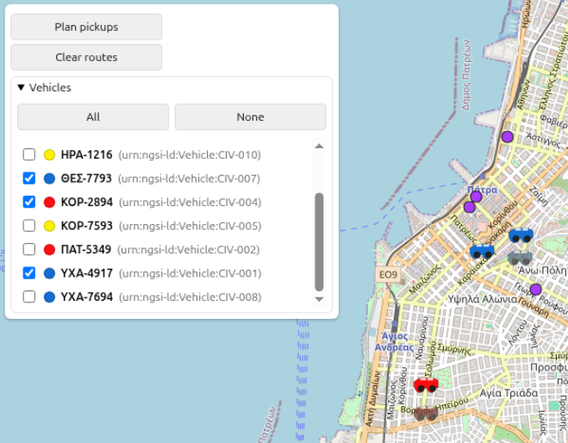
Demo app (Planning)
Depending on the size and impact of the natural disaster, the entire fleet may not be required for the evacuation of people in need.
The operator can select which vehicles should be included in the evacuation procedure.

Slide 17
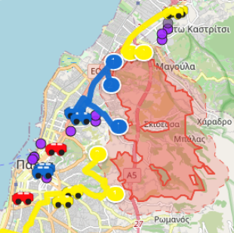
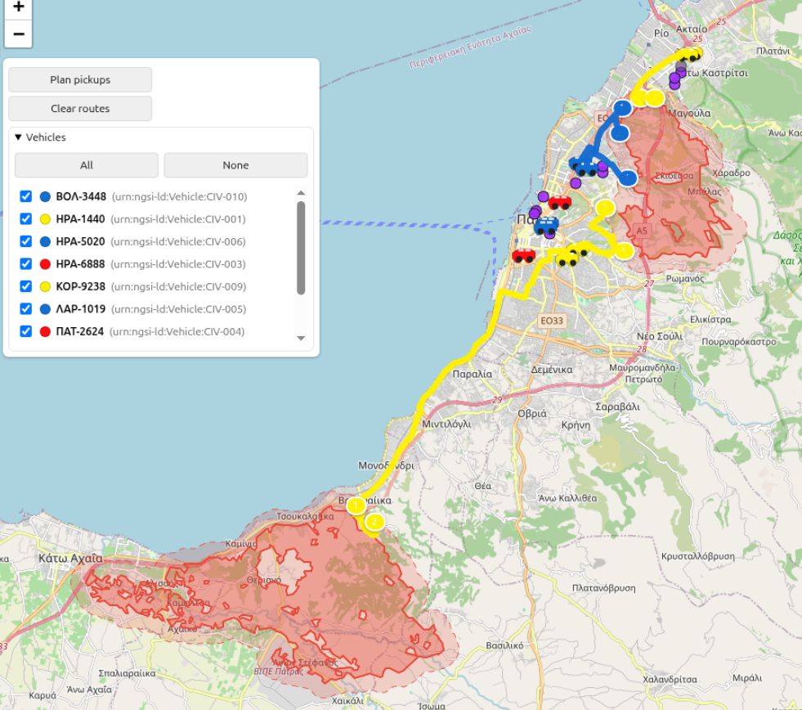
Demo app (dispatching)
The dispatching process calculates the optimal routes (using google CFR API) for each selected vehicle, according to their capacity, to reach the people inside the evacuation zones

Slide 18
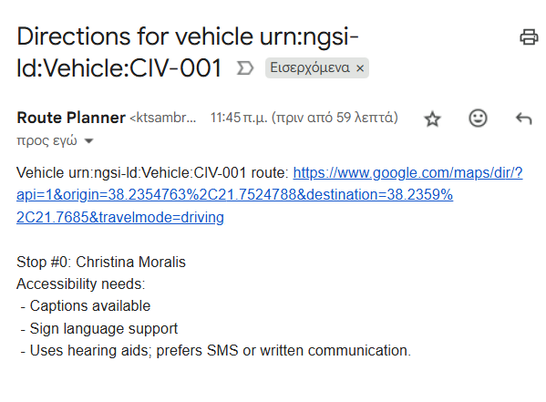
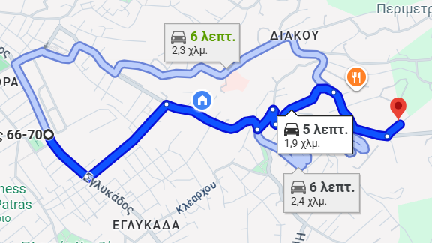
Demo app (notifying)
Each vehicle operator will receive an sms/email (based on their registered contact point) that provides critical info about their assigned route

Slide 19






Technologies used
Platforms:
IDS Reference Testbed: The backbone of the Dataspace
Docker & Docker Compose: Deployment of the Data Space
FIWARE Orion Context Broker (NGSI-V2): Real time fleet and context data management
Node.js: Backend runtime for APIs and demo App
Python: Fleet simulation
Postman, Git, VSCode for developing
Tools:
Leaflet.js: Interactive mapping
Turf.js: Geospatial calculations
Google Cloud Fleet Routing (CFR): Vehicle assignment
ORS: Route generation
Nodemailer: Mail dispatching
AES-256-GCM: Encryption/Decryption of sensitive data
OpenSSl/CFSSL: Certificate handling

Slide 20
More references
Implementation repository https://github.com/ultrongr/IDS-Civil-Protection/
IDSA https://internationaldataspaces.org/
Germany’s Mobility Data Space https://mobility-dataspace.eu/
Smart Connected Supplier Network https://smart-connected.nl/en
Health-X dataLOFT https://www.health-x.org/en/home
Copernicus EFFIS https://forest-fire.emergency.copernicus.eu/
Esri https://mobility-dataspace.eu/use-cases/esri
PrioBike-HH https://mobility-dataspace.eu/use-cases/priobike
Mobias https://mobility-dataspace.eu/use-cases/mobias

Slide 21

Thank you for your attention
Any questions?

